Slide 1

6th Grade Accelerated Math
Unit 13, Lesson 9 Subtracting Linear Expressions with Rational Coefficients Volume 2, pg. 307

Slide 2


Benchmark
MA.7.AR.1.1
Apply properties of operations to add and subtract linear expressions with rational coefficients.
volume 2, pg. 307

Slide 3
Integrated Mathematical Thinking and Reasoning Standards
MA.K12.MTR.2.1 Demonstrate understanding by representing problems in multiple ways.
MA.K12.MTR.3.1 Complete tasks with mathematical fluency.
MA.K12.MTR.4.1 Engage in discussions that reflect on the mathematical thinking of self and others.
volume 2, pg. 307

Slide 4

Learning Targets
I can subtract linear expressions with rational coefficients.
I can apply properties of operations to add and subtract linear expressions with rational coefficients.
volume 2, pg. 307

Slide 5

Warm-Up
volume 2, pg. 308

Slide 6
13.9.1 Warm-Up: Bell Work
Combine like terms.
$\left(3y+4.6\right)+\left(−5y−3.25\right)$ | $\left(6\frac{3}{4}x−7\right)+\left(−\frac{5}{2}x+7\right)$
volume 2, pg. 308

Slide 7

Exploration
volume 2, pg. 308

Slide 8

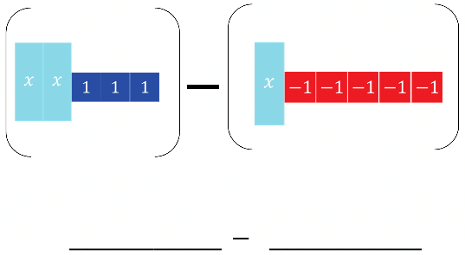
13.9.2 Exploration: Subtracting Expressions with Algebra Tiles
Algebra tile representations are given below. Use the algebra tiles to find the difference.
On the lines, write the algebraic expression for each representation.
Rearrange the tiles to show subtraction of like tiles together. Draw the representation.
volume 2, pg. 308

Slide 9
If necessary, create any zero pairs needed for subtraction.
Find the difference by subtracting (taking away) like tiles. Write the algebraic representation of the difference.
volume 2, pg. 308

Slide 10

Collaboration
volume 2, pg. 309

Slide 11

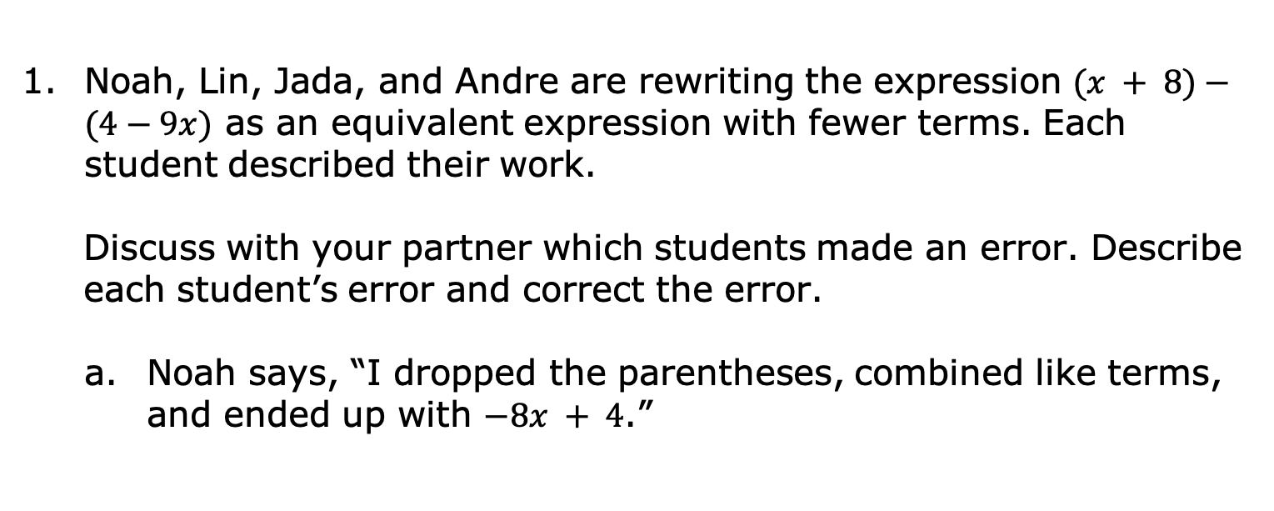

13.9.3 Collaboration: Subtracting Expressions
Noah, Lin, Jada, and Andre are rewriting the expression $(x + 8)−(4−9x)$ as an equivalent expression with fewer terms. Each student described their work.
Discuss with your partner which students made an error. Describe each student’s error and correct the error.
Noah says, “I dropped the parentheses, combined like terms, and ended up with $−8x + 4$.”
$$\left(x + 8\right)−(4−9x)$$
$$x + 8− 4−9x \\ −8x + 4$$
volume 2, pg. 309

Slide 12
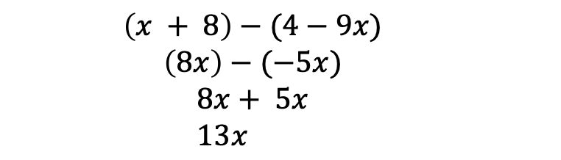
Lin says, “I simplified inside the parentheses and ended up with $13x$.”
$$\left(x + 8\right)−(4−9x)$$
$$\left(8x\right)−(−5x)$$
$$8x+ 5x \\ 13x$$
volume 2, pg. 309

Slide 13
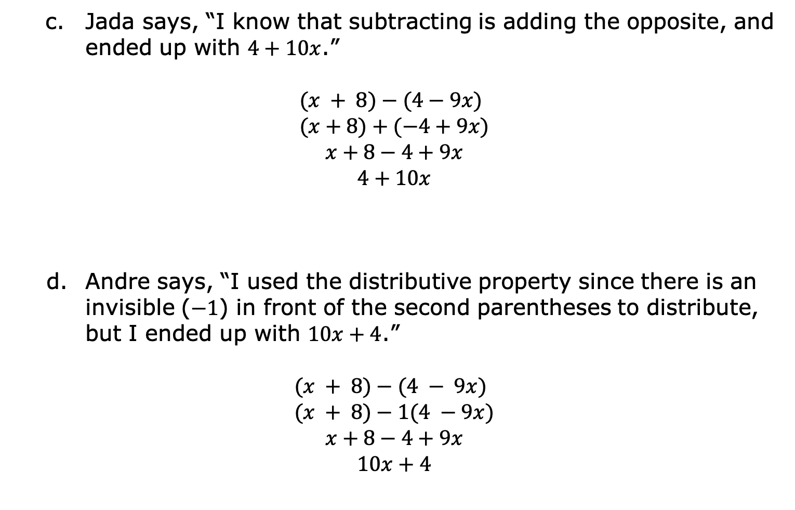
Jada says, “I know that subtracting is adding the opposite, and ended up with $4+10x$.”
$$(x + 8)−(4−9x) \\ (x+8)+(−4+9x)$$
$$x+8−4+9x$$
$$4+10x$$
Andre says, “I used the distributive property since there is an invisible ($−1$) in front of the second parentheses to distribute, but I ended up with $10x+4$.”
$$(x + 8)−(4 − 9x) \\ (x + 8)−1(4 −9x)$$
$$x+8−4+9x$$
$$10x+4$$
volume 2, pg. 309

Slide 14
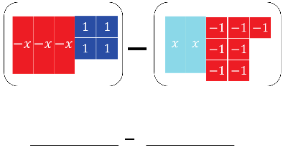
When subtracting expressions, use the distributive property to add the opposite. With the algebra tile representations below, model finding the difference by adding the opposite.
On the lines, write the algebraic expression for each representation.
Rewrite subtracting to adding the opposite by changing (or flipping) the sign of the 2nd expression. Draw the representation.
Combine any zero pairs to find the sum. Write the sum.
volume 2, pg. 310

Slide 15

Guided Instruction
volume 2, pg. 310

Slide 16
13.9.4 Guided Instruction: Subtracting Linear Expressions
To subtract linear expressions,
add the ______________, or additive inverse of each term in the expression.
OR
distribute a __________ to each term in the expression.
volume 2, pg. 310

Slide 17
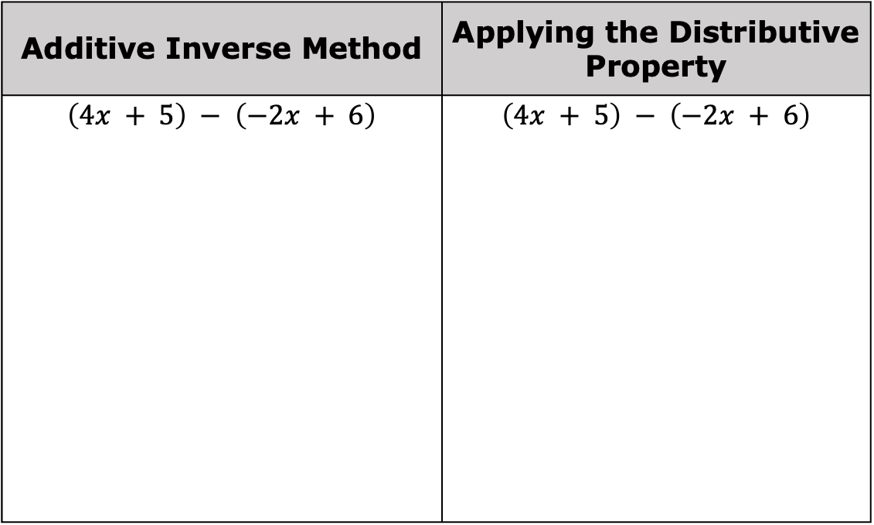
Complete the table to show both methods.
Additive Inverse Method | Applying the Distributive Property
$$\left(4x + 5\right) − \left(−2x + 6\right)$$ | $$\left(4x + 5\right) − \left(−2x + 6\right)$$
volume 2, pg. 310

Slide 18
When adding and subtracting, parentheses are used to group expressions. Why is the use of parentheses especially important when subtracting?
volume 2, pg. 310

Slide 19

Guided Practice
volume 2, pg. 311

Slide 20

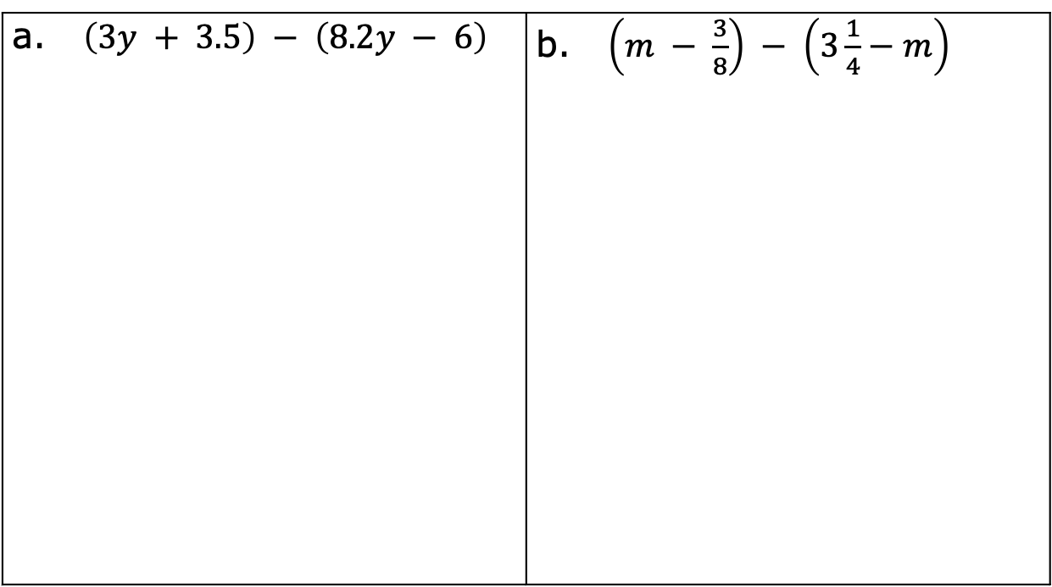
13.9.5 Guided Practice: Subtracting Linear Expressions with Rational Coefficients
Find the difference of each expression.
a. $\left(3y + 3.5\right) − \left(8.2y − 6\right)$ | b. $\left(m − \frac{3}{8}\right) − \left(3\frac{1}{4}−m\right)$
volume 2, pg. 311

Slide 21
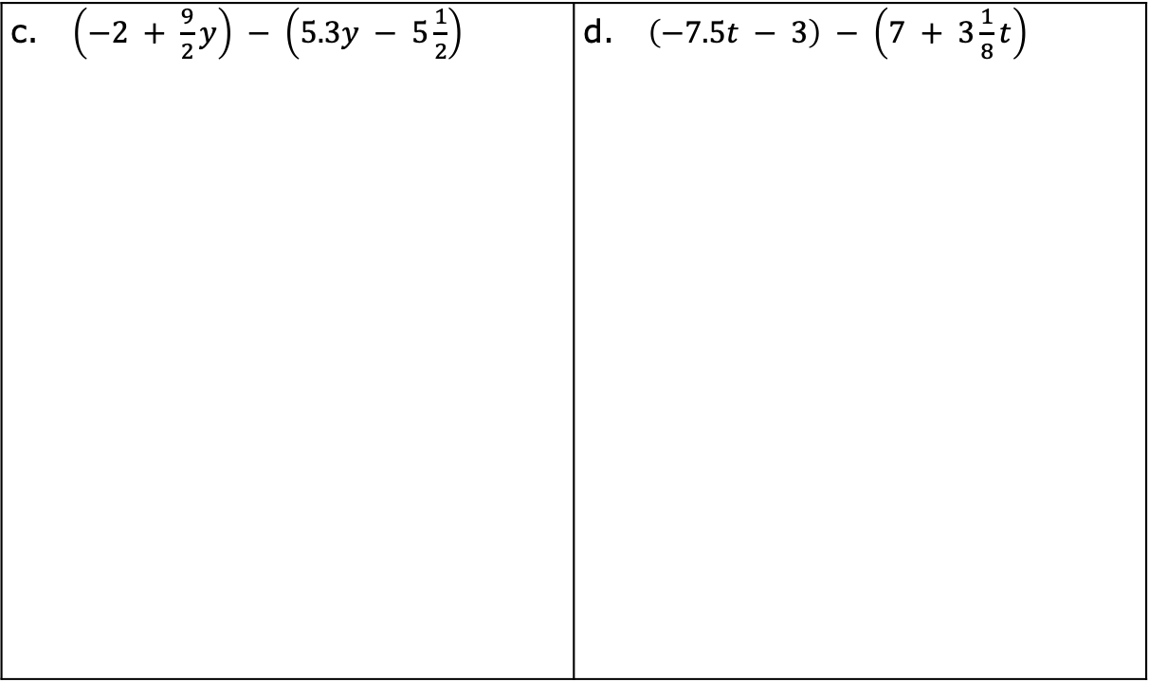
c. $\left(−2 + \frac{9}{2}y\right) − \left(5.3y − 5\frac{1}{2}\right)$ | d. $\left(−7.5t − 3\right) − \left(7 + 3\frac{1}{8}t\right)$
volume 2, pg. 311

Slide 22
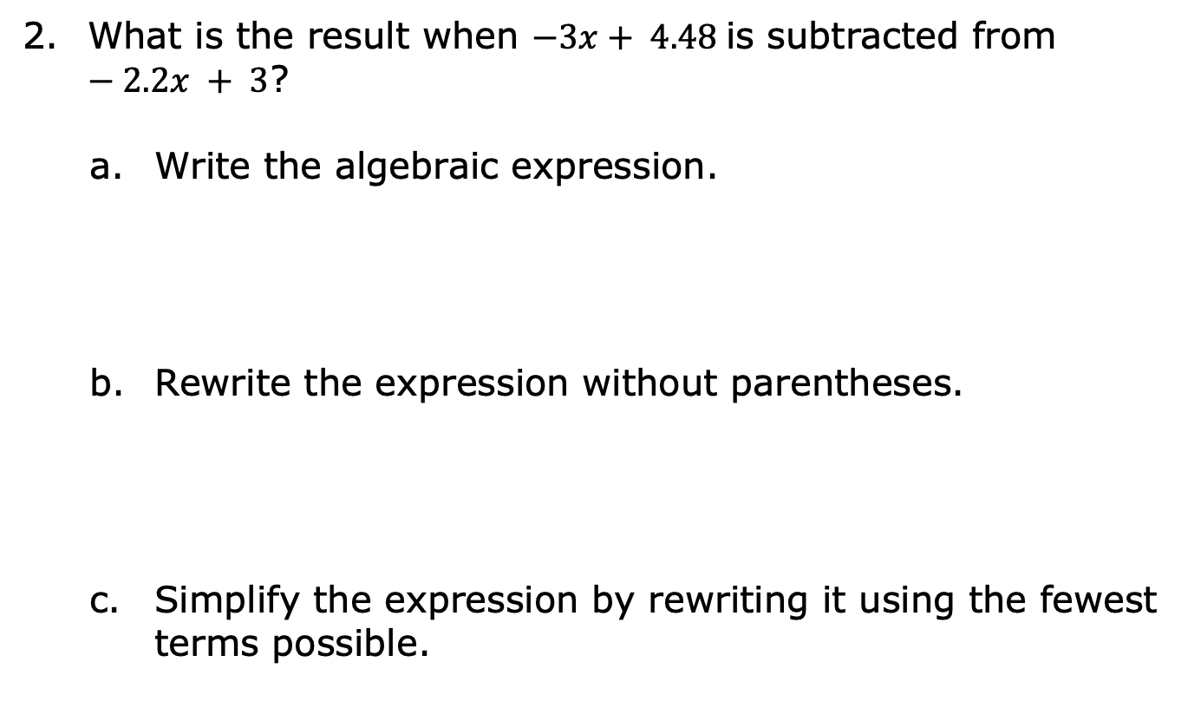
What is the result when $−3x+ 4.48$is subtracted from $−2.2x + 3$?
Write the algebraic expression.
Rewrite the expression without parentheses.
Simplify the expression by rewriting it using the fewest terms possible.
volume 2, pg. 311

Slide 23
Collaboration
volume 2, pg. 312

Slide 24
13.9.6 Collaboration: Adding and Subtracting Linear Expressions
Two students made errors when rewriting the expression $(6x+9)−(7−x)+(8x+11)$.
Zoe’s Work | Patricia’s Work
$$\left(6x+9\right)−\left(7−x\right)+\left(8x+11\right)$$ $$\left(6x+9\right)−\left(7x+18\right)$$ $$−x−9$$ | $$\left(6x+9\right)−\left(7−x\right)+\left(8x+11\right)$$ $$\left(5x+2\right)+\left(8x+11\right)$$ $$13x+13$$
volume 2, pg. 312

Slide 25
Working with your partner, write an explanation to Zoe that describes her error.
Write an explanation to Patricia that describes her error.
volume 2, pg. 312

Slide 26
Simplify the expression $(6x+9)−(7−x)+(8x+11)$.
volume 2, pg. 312

Slide 27

Your Turn
volume 2, pg. 313

Slide 28

13.9.7 Your Turn!
Rewrite each expression by combining like terms.
$(1 − 4y) − (2.5y + 7) − (− 0.3y + 3)$
$(3 \frac{1}{2} x − 4) + (x − 3.2) − (−\frac{1}{4}x + 9)$
$−(2r + 5) − (6 − 3r) + (10r − 4)$
volume 2, pg. 313

Slide 29

Wrap-Up
volume 2, pg. 313

Slide 30
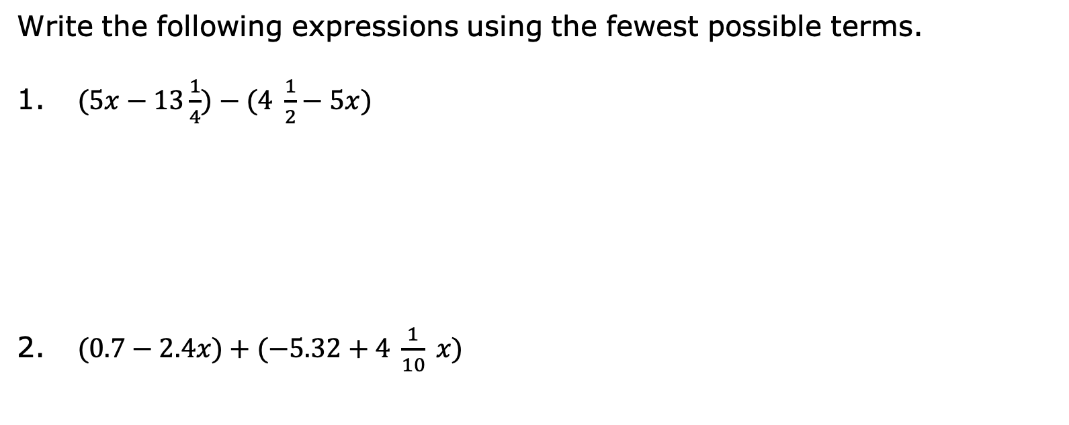
13.9.8 Wrap-Up: Ticket Out the Door
Write the following expressions using the fewest possible terms.
$(5x−13\frac{1}{4})−(4 \frac{1}{2}−5x)$
$(0.7−2.4x)+(−5.32+4 \frac{1}{10} x)$
volume 2, pg. 313

